Slide 1
DATA SCIENCE
Name : Tamil Arasan
College Name : Sri Vidya College of Engineering & Technologhy
Department : BE Mech

Slide 2
OUTLINE
Introduction
Mathematics and Statistics Fundamentals
Programming Languages and Tools
Data Collection
Data Cleaning and Preprocessing
Feature Engineering
Continuous Learning and Development
Conclusion

Slide 3
Introduction
Data science is an interdisciplinary field that utilizes scientific methods, algorithms, and systems to extract knowledge and insights from structured and unstructured data.
It combines elements of mathematics, statistics, computer science, and domain expertise to analyze data and make informed decisions.
In the digital age, vast amounts of data are generated daily from various sources such as social media, sensors, and transaction records. Data science helps organizations leverage this data to gain valuable insights and make data-driven decisions.
It enables businesses to enhance operational efficiency, improve customer satisfaction, and gain a competitive advantage in the market.

Slide 4
Mathematics and Statistics Fundamentals
Mathematics and statistics form the backbone of data science, providing the theoretical foundation and analytical tools necessary for understanding and working with data.
Linear Algebra:
Scalars, vectors, matrices, and tensors.
Matrix operations (addition, multiplication, transpose).
Eigenvalues and eigenvectors.
Singular Value Decomposition (SVD) and Principal Component Analysis (PCA).

Slide 5
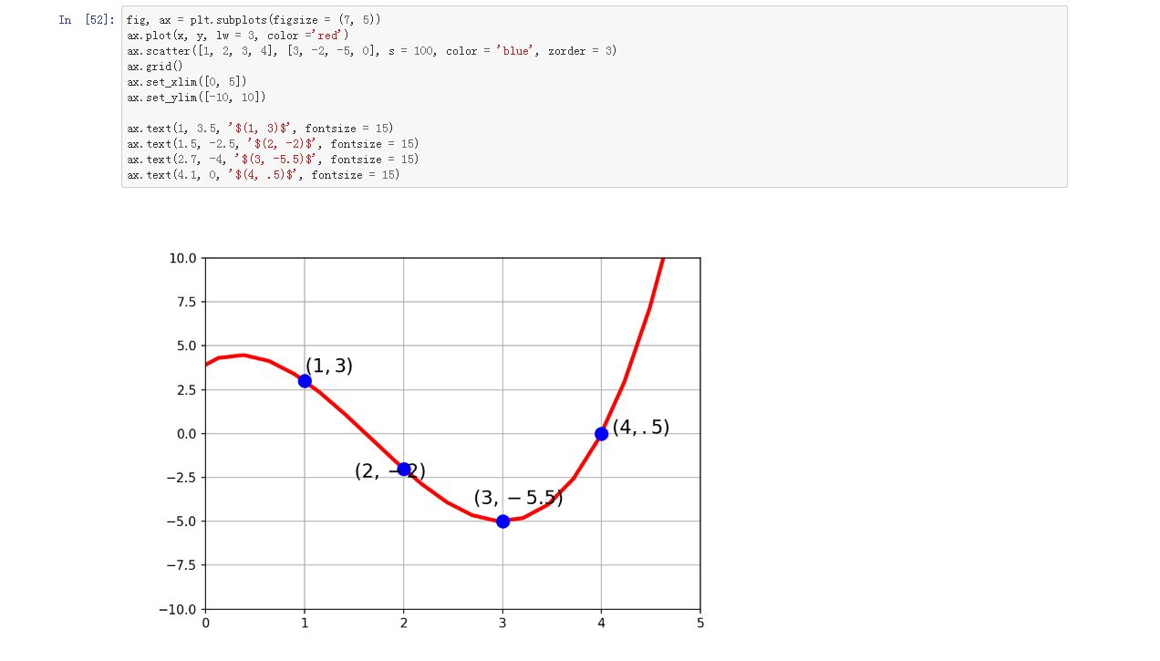

Slide 6
Programming Languages and Tools
Programming languages and tools are essential components of data science, enabling data scientists to manipulate, analyze, and visualize data efficiently. Here are the key programming languages and tools used in data science:
1. Python:
Widely used for data manipulation, analysis, and visualization.
Rich ecosystem of libraries such as NumPy, pandas, matplotlib, seaborn, scikit-learn, TensorFlow, and PyTorch.
Versatile language suitable for various tasks from data preprocessing to machine learning model development.
2. R:
Specialized for statistical computing and graphics.
Comprehensive collection of packages for statistical analysis and visualization (e.g., ggplot2, dplyr, tidyr).
Popular in academia and research settings for its robust statistical capabilities.
3. SQL (Structured Query Language):
Essential for querying and managing relational databases.
Used for data retrieval, manipulation, and aggregation in databases such as MySQL, PostgreSQL, SQLite, and Microsoft SQL Server.
Proficiency in SQL is crucial for working with structured dat

Slide 7
Data Collection
Data collection is a crucial step in the data science process, involving gathering raw data from various sources to use for analysis and modeling
Web scraping involves extracting data from websites using automated scripts or tools.
Libraries like BeautifulSoup (Python) and rvest (R) are commonly used for web scraping.
It's important to review and comply with the website's terms of service and legal guidelines when scraping data.
APIs provide a structured way to access data from web services, databases, or applications.
Many online platforms and services offer APIs for accessing their data, such as Twitter API, Google Maps API, and OpenWeather API.
Data can be collected from relational databases using SQL queries.

Slide 8
Data Cleaning and Preprocessing
Data cleaning and preprocessing are essential steps in the data science pipeline to ensure that the data is accurate, consistent, and suitable for analysis. Here's an overview of the key techniques and processes involved:
1. Handling Missing Values:
Identify missing values in the dataset (NaN, null, NA).
Decide on a strategy for handling missing values:
Removing rows or columns with missing values.
Imputing missing values using techniques such as mean, median, mode, or predictive modeling.
Using algorithms that can handle missing values internally (e.g., decision trees, random forests).
2. Data Transformation:
Normalization: Scaling numeric features to a standard range (e.g., 0 to 1) to ensure that all features contribute equally to the analysis.
Standardization: Transforming numeric features to have a mean of 0 and a standard deviation of 1 to simplify interpretation and improve model performance.
Logarithmic transformation: Transforming skewed data distributions to be closer to a normal distribution, which can improve the performance of certain algorithms.

Slide 9
Feature Engineering
Identify the most relevant features that contribute to the predictive power of the model.
Use techniques such as correlation analysis, mutual information, and feature importance ranking to select the most informative features.
Remove redundant or irrelevant features that do not add value to the model.
Convert categorical variables into numerical representations that can be used by machine learning algorithms.
One-hot encoding creates binary dummy variables for each category of a categorical feature.
Label encoding assigns integer labels to each category, often used for ordinal variables.
Scale numeric features to ensure that they have a similar range and distribution, preventing features with larger scales from dominating the analysis.

Slide 10
Continuous Learning and Development
Continuous learning and development are essential in the field of data science due to its dynamic nature and rapid advancements in technology and methodologies.
Follow industry blogs, forums, and social media channels to stay informed about the latest trends, techniques, and tools in data science. Engage in discussions, share insights, and learn from the experiences of others in the field.
Enroll in online courses, tutorials, and MOOCs (Massive Open Online Courses) offered by platforms like Coursera, edX, and Udemy. These platforms provide a wide range of courses covering various aspects of data science, machine learning, and related topics.
Read books, research papers, and academic journals to deepen your understanding of fundamental concepts and explore advanced topics in data science. Stay updated with new publications and research findings in the field.

Slide 11
Conclusion
In conclusion, data science has emerged as a powerful discipline that enables organizations to extract valuable insights from vast amounts of data, driving innovation, informed decision-making, and competitive advantage. With its interdisciplinary approach, data science combines techniques from mathematics, statistics, computer science, and domain expertise to tackle complex problems and uncover hidden patterns in data.
Key components of data science include data collection, cleaning, preprocessing, analysis, modeling, and interpretation. These processes involve a combination of technical skills, creativity, and critical thinking to transform raw data into actionable insights and solutions.

